Slide 1


Computer Engineering 2019/2020
Francisco Cordeiro 50037301

Slide 2
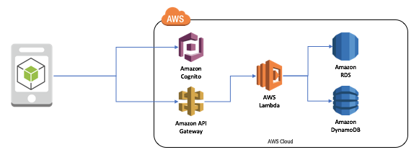

Slide 3
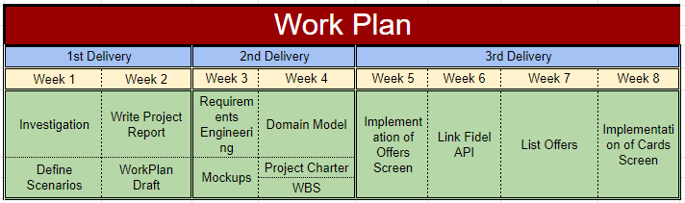
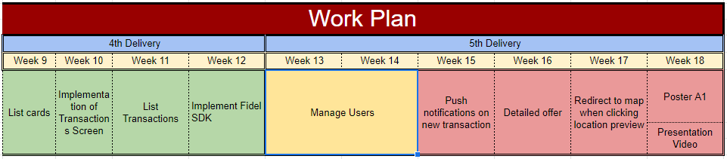

Work plan analysis

